Slide 1

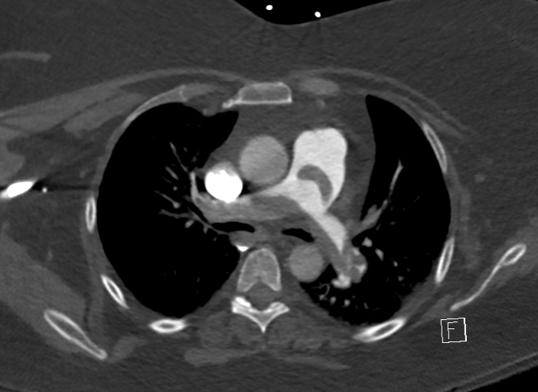
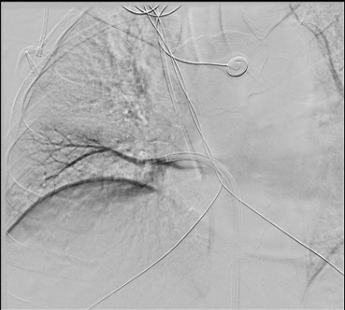
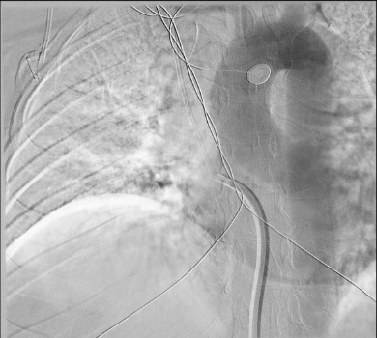
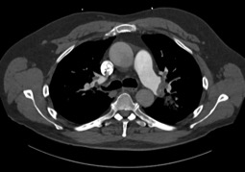
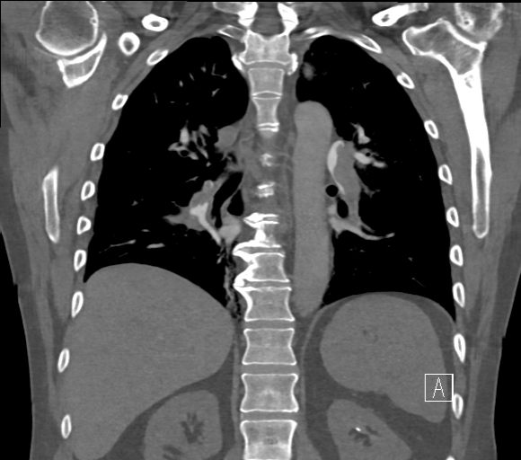
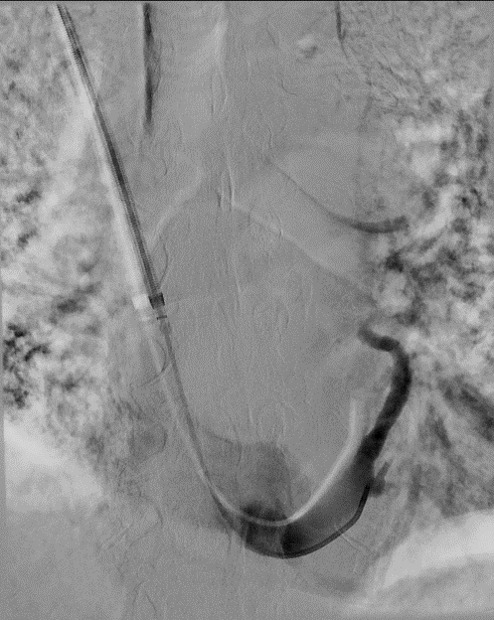
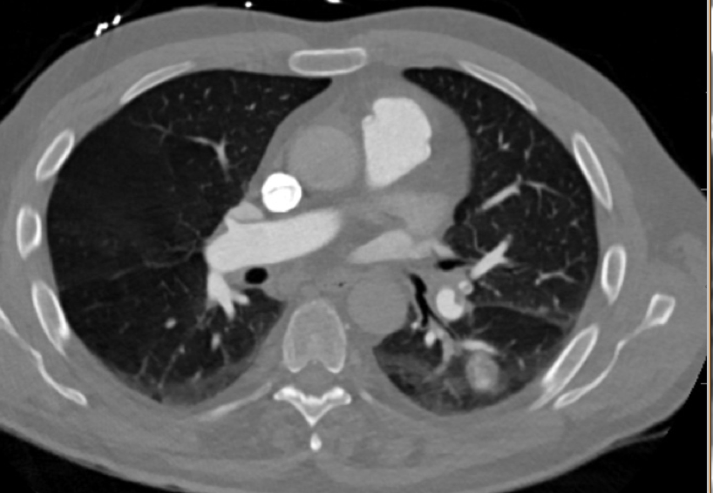
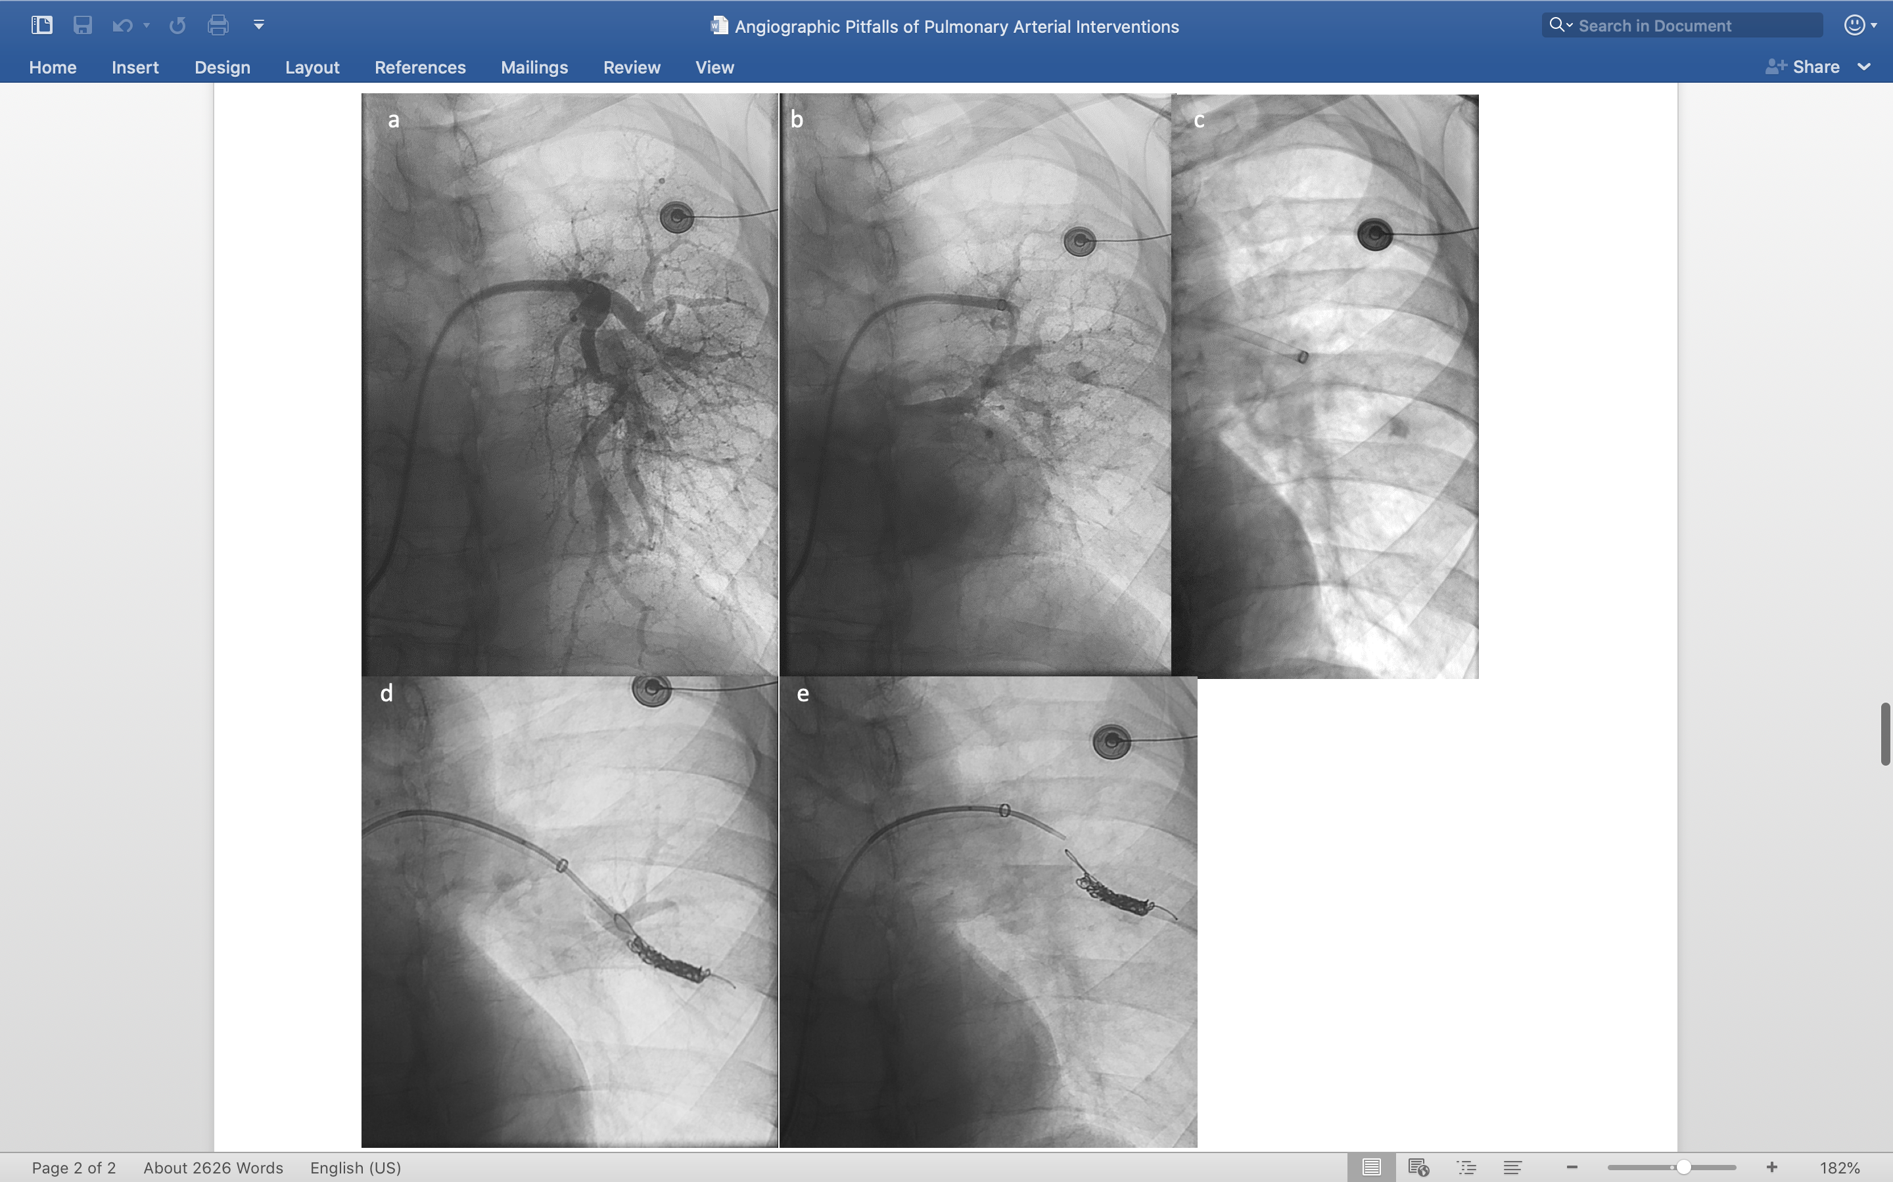
Angiographic Pitfalls for Arterial Interventions
Abdul Khan, MD, Gregory Woodhead, MD, PhD, Hugh McGregor, MD, Mikin Patel, MD, MBA, Charles Hennemeyer, MD
University of Arizona - Department of Medical Imaging, Department of Interventional Radiology
Purpose
Case Visuals
Case #3
Interventionists need to be aware of pitfalls associated with therapeutic angiographic procedures such as catheter directed treatment (CDT) for pulmonary embolism (PE). We report three cases in which the angiographic findings prompted awareness and education.
A
B
C
A 76-year-old male diagnosed with massive PE was referred for CDT. During aspiration thrombectomy, one of the left lower lobe segmental branches was repeatedly manipulated. After the procedures, the patient developed hemoptysis. Subsequent CT imaging revealed a left lower lobe pseudoaneurysm originating from one of two superior segmental branches of the anomalous six left lower lobe pulmonary segmental arteries. The pseudoaneurysm was subsequently coiled successfully.
Case #1
Figure 1. (a) Axial images of CT Chest. A filling defect is visualized in the main pulmonary trunk extending through right and left pulmonary arteries indicated presence of a saddle embolus. Fluoroscopic images of catheter angiography. (b) Diagnostic angiography with catheter advanced into the IVC , right heart and right to left shunt, with contrast delineating the right inferior pulmonary vein. (c) Retracted catheter into the right atrium shows aortic arteriogram confirming right to left shunt.
A 46-year-old female with massive PE was referred for CDT. After advancement into the presumed right pulmonary artery during catheterization, angiography revealed the vessel to be the right inferior pulmonary vein. As the catheter was retracted, contrast was noted to outline the aorta. Further retraction into the IVC raised the possibility of an intracardiac shunt as opposed to femoral artery access. An echocardiogram performed the subsequent day revealed a right to left shunt.
A
C
Conclusion
B
The implementation of CDT for PE as well as other angiographic pulmonary catheter treatments mandates increased awareness of potential pitfalls during angiography.
References
Figure 2. (a) Axial and (b) Coronal CT Chest showing filling defects in the left and right pulmonary arteries demonstrating PE.
(c) Angiographic views demonstrating the catheter was placed in the coronary sinus.
Jaff MR, Mcmurtry MS, Archer SL, et al. Management of massive and submassive pulmonary embolism, iliofemoral deep vein thrombosis, and chronic thromboembolic pulmonary hypertension: a scientific statement from the American Heart Association. Circulation. 2011;123(16):1788-830.
Kuo WT, Banerjee A, Kim PS, et al. Pulmonary Embolism Response to Fragmentation, Embolectomy, and Catheter Thrombolysis (PERFECT): initial results from a prospective multicenter registry. Chest. 2015;148(3):667–673.
Kasper W, Geibel A, Tiede N, Just H. Patent foramen ovale in patients with haemodynamically significant pulmonary embolism. Lancet. 1992;340(8819):561-4.
Kandathil A, Chamarthy M. Pulmonary vascular anatomy & anatomical variants. Cardiovasc Diagn Ther. 2018;8(3):201-207.
Shepherd F, White-stern A, Rahaman O, Kurian D, Simon K. Saddle Pulmonary Embolism with Thrombus in Transit across a Patent Foramen Ovale. Case Rep Cardiol. 2017;2017:6752709.
Gokhroo RK, Bisht DS, Padmanabhan D, Gupta S. Coronary sinus anatomy: Ajmer Working Group Classification. J Invasive Cardiol. 2014;26(2):71-4.
De maria GL, Kassimis G, Raina T, Banning AP. Reconsidering the back door approach by targeting the coronary sinus in ischaemic heart disease. Heart. 2016;102(16):1263-9.
Lawo T. [Anatomy, special features and angiographic assessment of the coronary sinus]. Herzschrittmacherther Elektrophysiol. 2006;17 Suppl 1:I1-6.
Habib A, Lachman N, Christensen KN, Asirvatham SJ. The anatomy of the coronary sinus venous system for the cardiac electrophysiologist. Europace. 2009;11 Suppl 5:v15-21.
Ghaye B, Dondelinger RF. Imaging guided thoracic interventions. Eur Respir J. 2001;17(3):507-28.
Case #2
A 65-year-old male diagnosed with submassive PE was referred for CDT. During catheterization, contrast injection showed the catheter to be in the coronary sinus mimicking right ventricular outflow. The catheter was retracted and positioned correctly with subsequent successful thrombectomy.
A
B
C
D
E
Figure 3. (a) CT Angiogram showing small residual eccentric filling defects in all the proximal segmental branches for the left lower lobe, and downstream subsegmental arteries. A partially enhancing saccular lesion is noted in a lateral subsegmental branch of the left lower lobe, in keeping with a pseudoaneurysm. Angiographic views of the left lower lobe pseudoaneurysm. (b) initial angiogram (c) visualization of pseudoaneurysm (d) coiling of aneurysm (e) post coil embolization.

