Slide 1
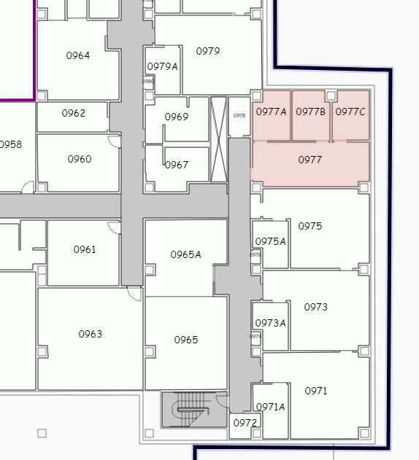
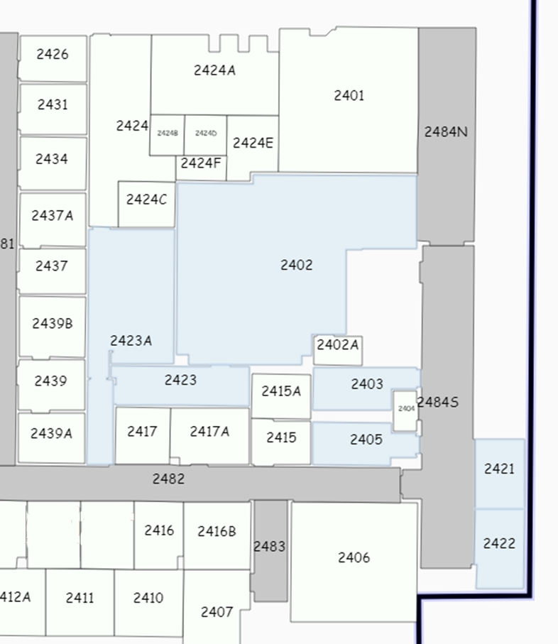
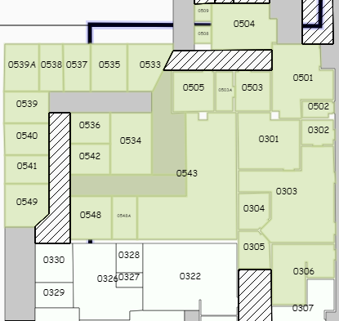
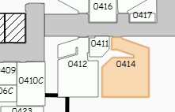
Residency & Fellowship Team
Clinical
Faculty
Administration& Faculty
Research
Faculty & Team
Cancer Center BASEMENT 0977
COM-T Tower 4 2nd FLOOR
COM-T Tower 4 BASEMENT
BSRL 2nd Floor & AHSC 0414 (lab)
NEW locations: April 2024

