Slide 1
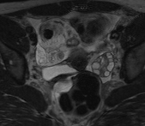


Diagnostic Performance of MR Imaging in the Detection of Ovarian Torsion
Cory Spicer, Abdul Khan, Srini Vedantham,
Bobby Kalb, Hina Arif
University of Arizona College of Medicine

Slide 2
Disclosure Statement
Neither I nor my immediate family members have a financial relationship with a commercial organization that may have a direct or indirect interest in the content

Slide 3
Objectives
Background of Ovarian Torsion (OvT)
Purpose of Study
Materials and Methods
Results
Discussion
Conclusion

Slide 4
Background
Abdominal and Pelvic Pain⁽¹⁾
    Nearly 23 million emergency department (ED) visits yearly
Ovarian Torsion Incidence⁽²⁾
    Uncommon cause of gynecological emergency with 2-3% incidence rate of gynecological emergencies.
    Imaging plays an important role evaluating these patients.

Slide 5
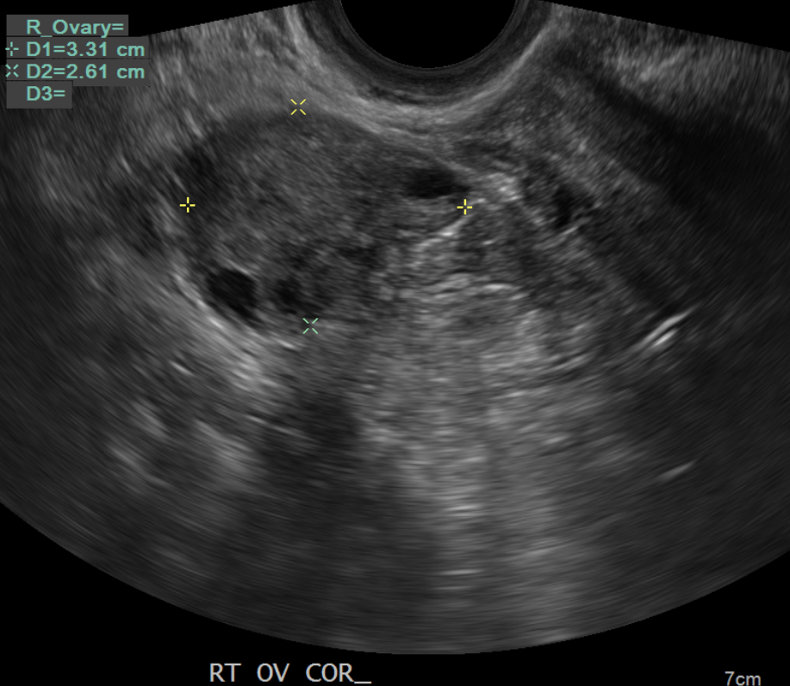
Background
ACR guidelines: Ultrasound (US) is first line for diagnosing OvT⁽³⁾
US has limitations:
    Due to dual vascular supply to the ovaries, presence of blood flow on color doppler imaging, both arterial and venous, does not exclude OvT⁽⁴⁾
    Reported sensitivity of US for OvT is 51%⁽⁵⁾

Slide 6
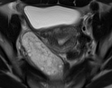
Background
Magnetic resonance imaging holds promise as a first line imaging modality for diagnosing ovarian torsion.
Benefits:
    Better soft tissue contrast
    Improved evaluation of ovarian parenchyma
    Better evaluation of surrounding structures to evaluate alternative diagnosis

Slide 7
Purpose
Determine the sensitivity and specificity of MRI in the detection of ovarian torsion in patients (ages 5-54) that presented to the emergency department with clinically suspected ovarian torsion.

Slide 8
Material and Methods
IRB approved, HIPAA compliant, institutional clinical protocol utilizing non-contrast MRI and contrast MRI for patients presenting to the ED with abdominal/pelvic pain.
Retrospective review of clinical reports (2015-2019), were classified as
    Positive
    Negative

Slide 9
Material and Methods
Positive MRI reference standard
    Surgery operative note stating ovarian torsion
    Clinically positive for ovarian torsion, but surgery deferred

Slide 10
Material and Methods
Negative MRI reference standard
    Surgery operative note reviewed when surgery performed for other indication besides OvT
    Cystectomy, ovarian mass without torsion, appendicitis, etc.
Medical Records review
Alternative diagnosis given or pain resolved and a follow up note was reviewed.

Slide 11
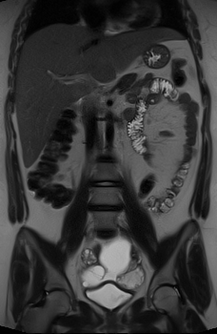
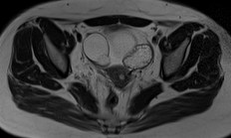
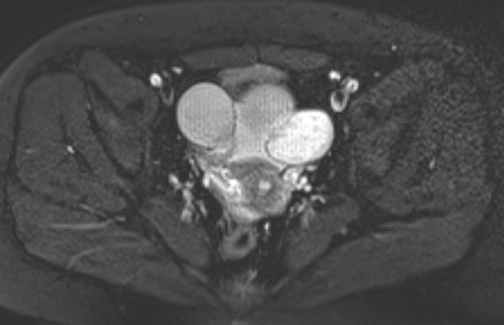
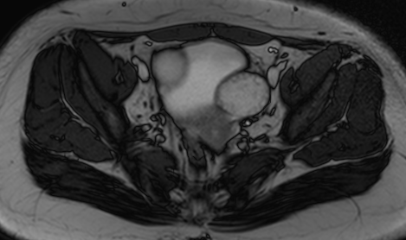
Material and Methods
MR Image acquisition for pelvic evaluation
1.5 or 3.0 T system
Axial T2
Axial T2 Fat Saturation
TRUFISP / SSFP
Coronal T2

Slide 12
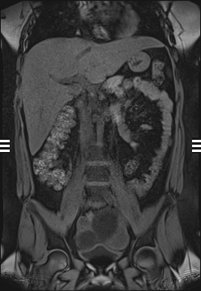
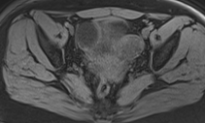
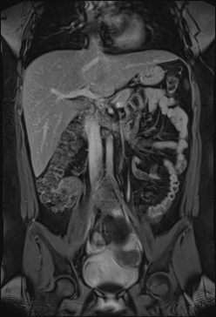
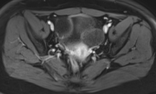
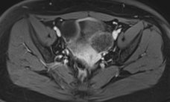
Material and Methods
MR Image acquisition
    Post contrast sequences
Coronal
Pre-T1
Axial Pre-T1
Coronal
Delayed
Axial Venous
Axial Delayed

Slide 13
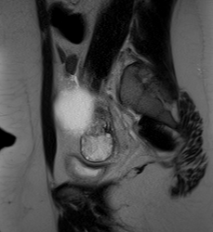
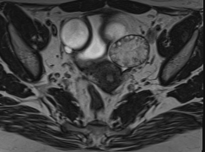
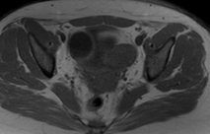
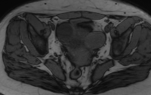
Material and Methods
MR Image acquisition for pelvic evaluation
Axial IN Phase
Axial OUT Phase
High resolution small field of view axial T2 – T2 SPACE or T2 Cube
Sagittal T2

Slide 14
Results
Patients scanned with
MRI for suspected OvT
n=134
High clinical suspicion
surgery deferred
n=4
(1 perimenopausal
1 pregnant did not
want to risk fetus injury
2 diagnosed with
intermittent torsion
MRI positive for OVT
n=42
MRI negative for OvT
n=92
Surgery negative
for OvT
n=6
Surgery positive
for OvT
n=32
Surgery Negative
For OvT
n=30
Alternative diagnosis and/or
negative retrospective
chart review
n=62
Notes:
Read the slide

Slide 15
Results
Table 1. Summary of Diagnostic Performance Measures
Metric | Point estimate | Clopper-Pearson (exact) 95% CL
Sensitivity | 100% (36/36) | 90.26% - 100%
Specificity | 93.9% (92/98) | 87.2% - 97.7%
PPV | 85.7% (36/42) | 71.5% - 94.6%
NPV | 100% (92/92) | 96.1% - 100%
Accuracy | 95.5% (128/134) | 90.5% - 98.3%

Slide 16
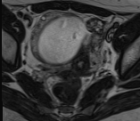
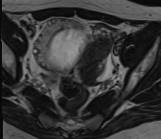
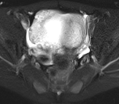
Results
18 year old presents with right lower quadrant abdominal pain
T2 SPACE: Right ovary (RO) 7 cm cyst, peripheralized follicles
T2 Fat Sat: RO stromal edema

Slide 17
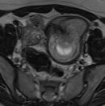
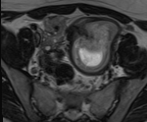
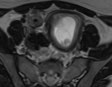
Results
18 year old presents with right lower quadrant abdominal pain (cont)
T2 SPACE: Twisted pedicle
Right ovarian torsion and simple cyst confirmed at surgery

Slide 18
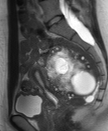
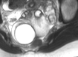
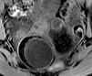
Results
Axial T2: Perifollicular
hemosiderin rim
Sag T2: Perifollicular
hemosiderin rim
Pre T1: Perifollicular hemorrhage
indicates nonviable ovary⁽⁶⁾
Torsion and nonviable ovary confirmed on surgery

Slide 19
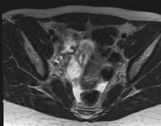
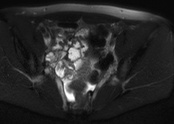
Results
18 year old presents with right lower quadrant abdominal pain
T2: Normal right ovary
T2 Fat Sat: No torsion or right ovary edema
Pain resolved and follow up with OB/GYN was negative for torsion

Slide 20
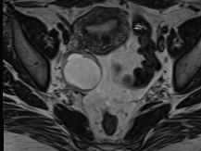
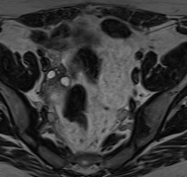
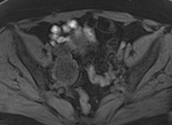
Results
28 year old presents with right lower quadrant abdominal pain
T2 SPACE: Right ovary (RO) hemorrhagic cyst, normal ovarian stroma
PreT1: RO cyst with intrinsic hyperintense signal, hemorrhagic cyst
No torsion and hemorrhagic cyst confirmed on surgery

Slide 21
Discussion
    US is first line for evaluation of OvT; however sensitivity is 51%⁽⁵⁾
    Exquisite soft tissue details of MR imaging merits evaluation of ovarian stromal edema and twisted pedicle.
High clinical value of MR imaging
    Exceedingly high sensitivity of MR favors increased utilization of this modality despite challenges of availability and expertise
    High NPV emphasizes role of MR in excluding torsion in a noninvasive/nonoperative way. Thereby, reducing overall diagnostic laparoscopies and healthcare costs.

Slide 22
Conclusion
MR imaging is a highly sensitive and specific test in the evaluation of patients with pelvic pain and suspected ovarian torsion.
High negative predictive value of MR in excluding ovarian torsion can save health care costs by avoid diagnostic laparoscopy performed in patients with clinically suspected torsion

Slide 23
References
Shung RE et al. US emergency department visits for adults with abdominal and pelvic pain (2007-2013): Trends in demographics, resource utilization and medication usage. The American Journal of Emergency Medicine. 2017; 35(12):1966-1969.
Hibbard LT. Adnexal torsion. American Journal Obstetrics Gynecology. 1985; 152(4):456-461.
Bhosale PR et al. American College of Radiology ACR Appropriateness Criteria Acute Pelvic Pain in the Reproductive Age. 2015.
Changa KH et al. Conservative therapy of adnexal torsion employing color doppler sonography. The Journal of the American Association of Gynecologic Laparoscopists. 1998; 5(1):13-17.
Oltmann SC et al. Cannot exclude torsion – a 15 year review. Journal of Pediatric Surgery. 2009; 44:1212-1217.
Petkovska I et al. MRI of ovarian torsion: Correlation of imaging features with the presence of perifollicular hemorrhage and ovarian viability. European Journal of Radiology. 2016;85:2064-2071

Slide 24

QUESTIONS
Contact: Cory Spicer, cspicer@radiology.arizona.edu

